Slide 1
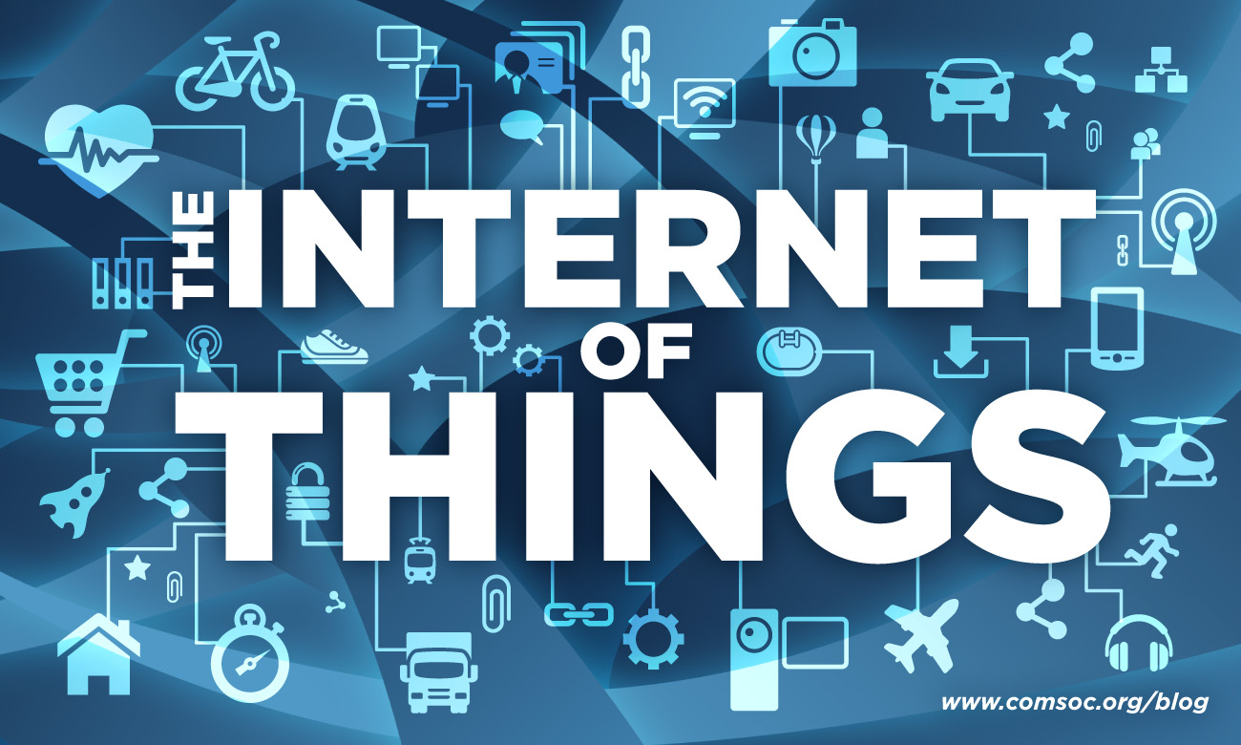

Slide 2
Internet of Things
Definition:
The network of physical objects or "things" embedded with electronics,
software, sensors, and connectivity to enable objects to exchange data with
the manufacturer, operator and/or other connected devices based on the
infrastructure of International Telecommunication Union's Global Standards Initiative.
The Internet of Things allows objects to be sensed and controlled remotely across
existing network infrastructure, creating opportunities for more direct integration between the physical world and computer-based systems, and resulting in improved efficiency, accuracy and economic benefit. Each device is uniquely identifiable through its embedded computing system but is able to interoperate within the existing Internet infrastructure.

Slide 3
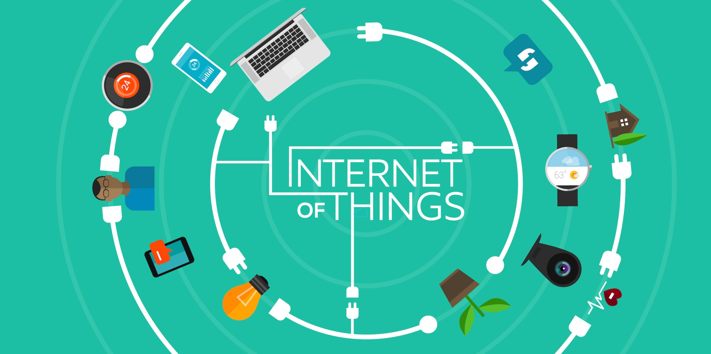
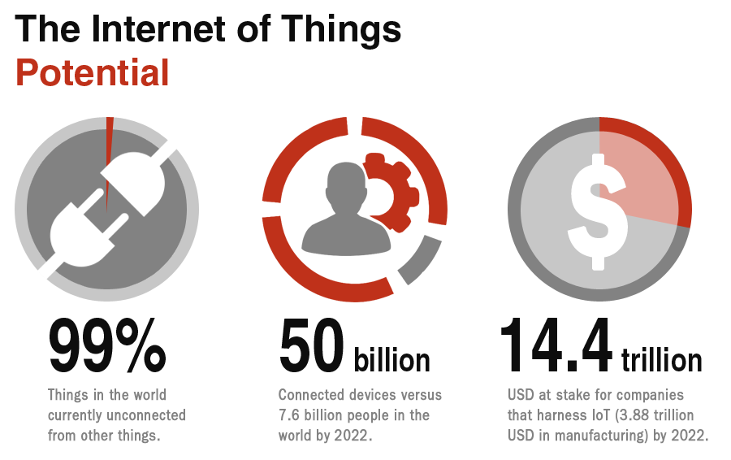

Slide 4
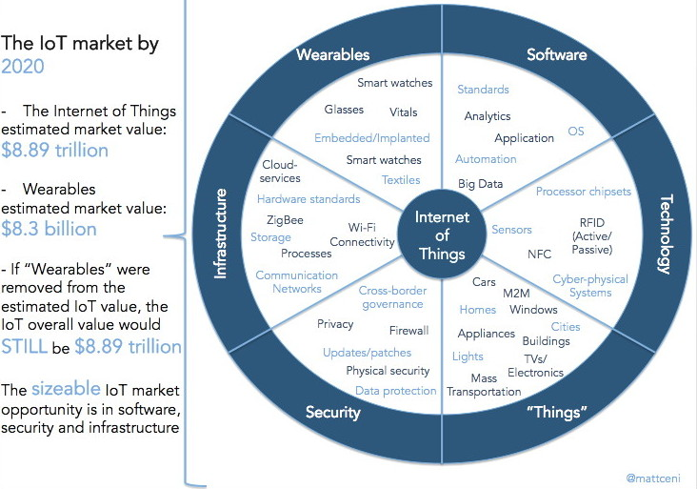

Slide 5
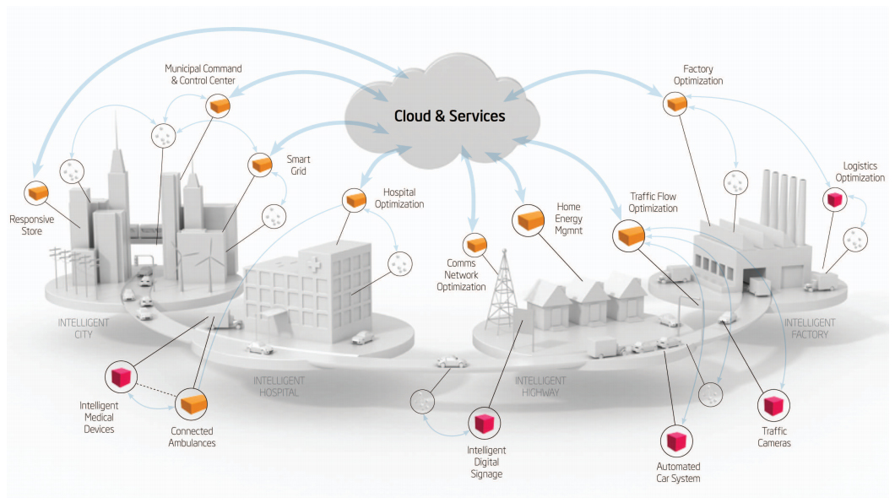

Slide 6



Slide 7
Web Links:
https://en.wikipedia.org/wiki/Internet_of_Things
http://www.wired.com/2014/11/the-internet-of-things-bigger/
http://www.theinternetofthings.eu/
http://www.cisco.com/web/solutions/trends/iot/overview.html
http://whatis.techtarget.com/definition/Internet-of-Things
http://iofthings.org/#home
http://www.itu.int/en/ITU-T/gsi/iot/Pages/default.aspx

